Slide 1
VidGrid and Zoom
Adding video to your classes

Slide 2
VidGrid - Video Capture, Caption, and Stream
Video can be captured from a webcam or screencapture
  You can also upload an existing video
Audio alone can be captured as well
Captions are created with a couple of clicks
  Don’t forget to proof-read and edit as necessary
Completed videos are shared via a link in Moodle
Can create assignments that enable students to upload video or audio files
Can embed questions within a video!

Slide 3
Zoom – review sessions, tutoring, advising, meetings
Real-time online meetings
Host (instructor) must be online and has to have at least a microphone & speakers – webcam optional
Participants must have speakers at least
Device agnostic – yes, phones and ipads work
Shared licenses within the departments
Meeting links can be put in Moodle and/or emailed

Slide 4
Zoom Meetings and Webinars

Slide 5
Scheduling a meeting with Zoom
https://zoom.us/
Sign in using assigned login/password
  DO NOT CHANGE PASSWORD!
  Click on Meetings to ensure no conflicts with your desired day/time
  DO NOT DELETE any meetings that are not yours
Click Schedule a Meeting
Title meeting, set date/time/duration
Generate Meeting ID automatically
Normally, do not require meeting password (be sure to uncheck this)
Set video/audio initial settings
Options:
  Check enable join before host
  UNCHECK mute participants upon entry
Save and meeting info appears on next page

Slide 6
Meeting Info and Invite your guests
IMPORTANT – proof the meeting name, time/date for accuracy
Note the MEETING ID – it will be needed to enter the session
Invite attendees – two methods:
  Copy all meeting invitation information and paste in Moodle and/or email
  Just copy the meeting URL and paste in Moodle and/or email
Be sure to send the meeting info to your attendees AND yourself as a backup!

Slide 7
Starting the Zoom Meeting
Log into Zoom
Remember the meeting id?
  Click Join a Meeting
  Enter the Meeting ID generated when meeting was scheduled and Join
Don’t have the meeting id handy?
  Click on Meetings
  Find the desired session and click START
Zoom will need to install on your computer – be sure to allow its installation

Slide 8
Meeting Controls – left to right
Mute/unmute microphone
Start/Stop video
Invite members
Participants
Share screen
Chat (click to open chat window)
Record (optional – let’s talk)
Reactions (allows thumbs up/thumbs down responses)
End meeting

Slide 9
Webinars
Different than Meetings
Must be scheduled through the DL office
Difference between the two
  Meetings are collaborative with all members able to screen share, control their audio/video, and see all in attendance.
  Webinars are view-only attendees with Q&A, chat, and answering polling question abilities. Host can unmute attendees.

Slide 10
COMING SOON…
Integration into Moodle so scheduling, hosting, and joining the meeting are all conducted within Moodle
More to come – some technical issues to resolve, but probably after the Moodle 3.7 upgrade (coming for Summer 2020)
###

Slide 11
VidGrid – videos

Slide 12
VidGrid
URL: app.vidgrid.com
Username: your email address
Password: https://app.vidgrid.com/password/email
First time on a device – follow the prompts to install the recorder
Integration into Moodle has run into problems…which limits your ability to automatically be logged in to VidGrid, but does not limit what you can do with VidGrid

Slide 13
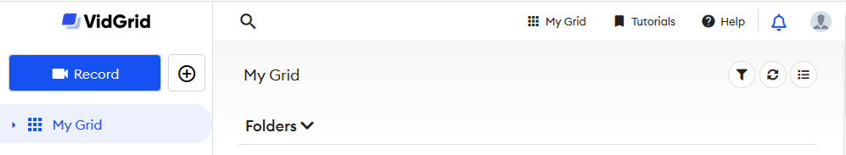
Main Screen
Great tutorials!
Click here to get started!

Slide 14
First things first – Tutorials to view
Installing the VidGrid Recorder
Recording a Video
Recording Webcam only
Adding Video Captions
Set Sharing and Permissions
  Use link (not embed) most of the time

Slide 15
Let’s Create a Video
Log into VidGrid
Click on the RECORD button
  First time on a computer – download the recorder
Follow prompts to adjust capture size
Begin recording
End recording
Preview, and if satisfied, go to the next step. If not, click on the REDO icon and start over.
Once finished, permissions, links, and captions are left to do

Slide 16
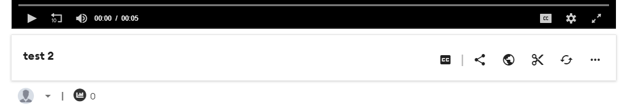
Captions, every time…
Once the recording is completed, you can caption
Click the CC button
Select the AUTOMATIC captions (left button)

Slide 17
Editing Captions
Quick way to review is using the transcript – makes it two steps, but is easier than starting/stopping all the time

Slide 18

Sharing your Video
Click the share icon
Copy the url in the Send Link box
Paste in Moodle or email

Slide 19
Permissions
Don’t forget this step…or you’ll be flooded with students with issues!
Click the globe and find Who can view this video?
Make sure ANYONE WITH A LINK is checked.
Other settings are optional

Slide 20
Other editing options
While VidGrid can edit, it is easier to edit in another program such as Camtasia. Ask us later…
If you don’t like the video, you can re-do it using the redo icon
The “more” icon gives other options such as preview, download, and delete

Slide 21
How long should a video be?
Generally speaking, for video online, the magic number for optimal engagement appears to be between 2 to 5 minutes. Studies examining engagement with YouTube videos consistently show solid viewership through the first 2 minutes of a video, a gradual decline in engagement after 2 minutes, and a sharper drop after 5 minutes.
https://www.panopto.com/blog/how-long-should-training-videos-be/

Slide 22
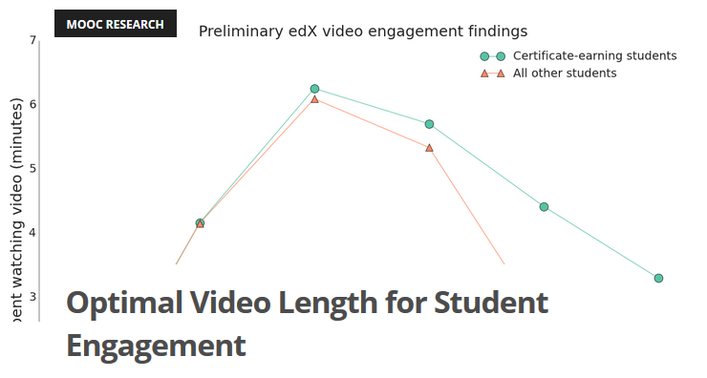
https://blog.edx.org/optimal-video-length-student-engagement/

Slide 23
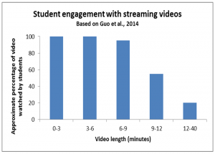
https://cft.vanderbilt.edu/guides-sub-pages/effective-educational-videos/student_engagement_videos-2/

