Slide 1
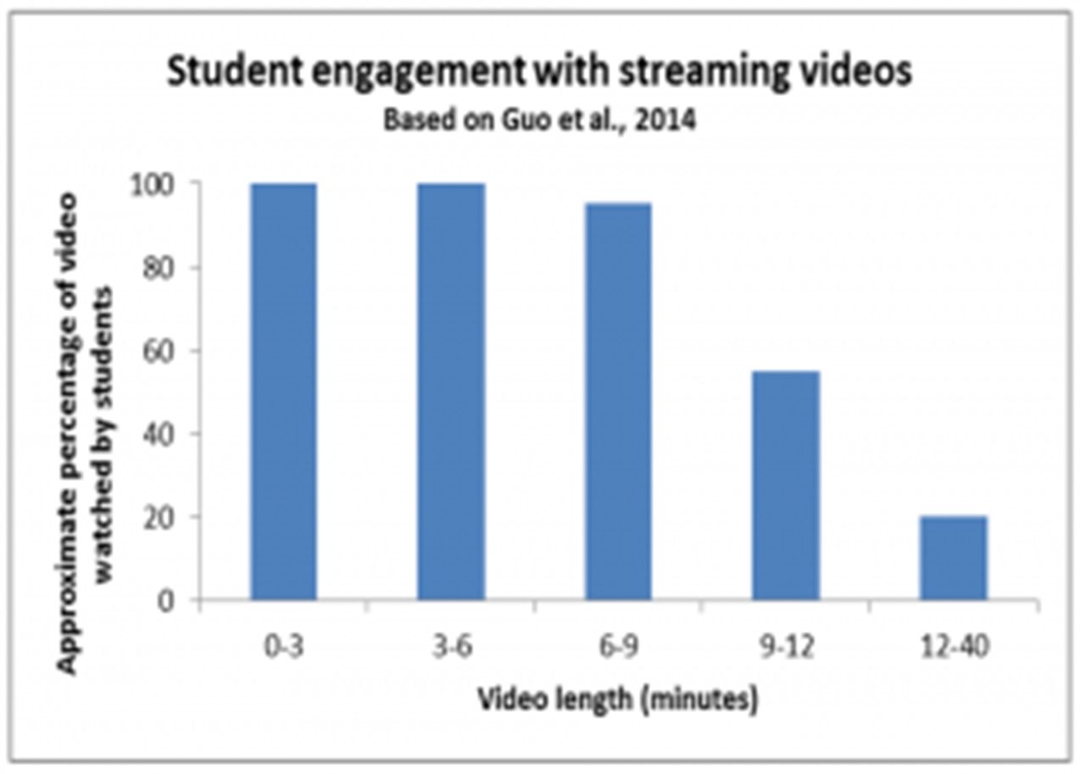
https://cft.vanderbilt.edu/guides-sub-pages/effective-educational-videos/student_engagement_videos-2/

Slide 2
How long should a video be?
Generally speaking, for video online, the magic number for optimal engagement appears to be between 2 to 5 minutes. Studies examining engagement with YouTube videos consistently show solid viewership through the first 2 minutes of a video, a gradual decline in engagement after 2 minutes, and a sharper drop after 5 minutes.
https://www.panopto.com/blog/how-long-should-training-videos-be/

Slide 3
https://blog.edx.org/optimal-video-length-student-engagement/

Slide 4
Chunk it into six-minute segments!
Start with topic and think about how to break down material
Muscular system has three parts – skeletal, cardiac, and smooth muscles
Basic math – add, subtract, multiply, and divide
XYZ war – history and causes, triggers, battles/key events, outcome and results
Labor and delivery: early labor/admittance to maternity ward, advanced labor, delivery, post-partum
Investigation: collection of information, validation, and preservation
Think natural breaks in the material – places to ask questions, etc.

Slide 5
Keep it succinct!

Slide 6
Don’t be a talking head

Slide 7
Don’t worry about making a mistake. Students like you to be human.

Slide 8
Think reuse. Keep semester- and section-specific material separate from course material videos

Slide 9
Videos can be linked in multiple classes

Slide 10
Make videos topic-based, not chapter-based…makes reusing easier!

Slide 11
Add a welcome video – good practice and creates a better course atmosphere

Slide 12
Name the video appropriately Causes of WWII, not Week 3 Video

Slide 13
Breaking material into chunks makes updating easier

Slide 14
“…the most boring thing that I could think of to do...a talking head: a middle-class white male in a suit, talking to them in a really boring way about music videos“…
Rocky Morton, creator of Max Headroom

Slide 15
Think of worksheets (or embedded questions) to facilitate active learning

Slide 16
Think complementary resource, not redundant materials. Explain the tricky points and emphasize the main points

Slide 17
Utilize both headshots and imagery (just don’t forget to explain the images!)

Slide 18
Caption… Caption… Caption…

Slide 19
Include a two-three sentence intro to the material. Include such phrases as “pay attention to…,” “you’ll see ___again,” to cue the viewer to critical info

