Slide 1
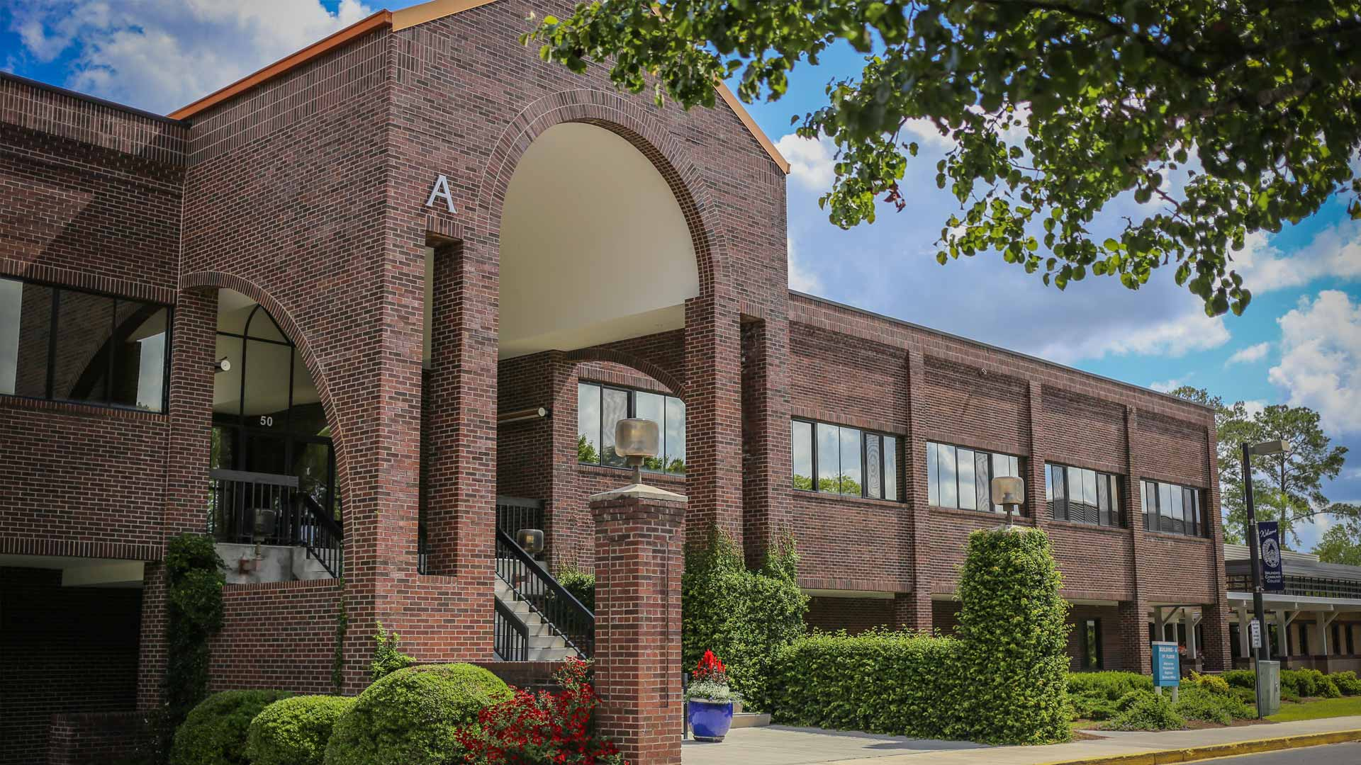
About the College
Brunswick Community College is a tax-supported, public, nonprofit school located in North Carolina. It was established in July 1979 as Brunswick Technical Institute and in 1988 became known as Brunswick Community College. BCC’s main campus is located in Bolivia, NC but also offers classes at its Leland and Southport satellite campuses.
BCC serves 142,820 Brunswick County residents, offering over 29 Associate degrees, 12 diplomas, and 27 certificate for-credit programs and numerous continuing education non-credit opportunities for students to enhance their careers, obtain new trade skills, open and operate a small business, as well as many personal enrichment courses.
Class sizes average 10-20 students with a 12:1 Student-Faculty Ratio
Annually enrolling approximately 1,500 Curriculum and 2,500 Continuing Education students through on-campus and online course offerings
Awarding students over $4.2 million in Financial Aid, Grants and Scholarships
School colors
Teal, Navy, and Cobalt
Mascot
Dunkin’ the Dolphin

Slide 2
College Mission
Brunswick Community College provides opportunities for individuals to be successful through accessible, high quality, student-centered programs and services that meet the educational, cultural and workforce needs of the community.

Slide 3
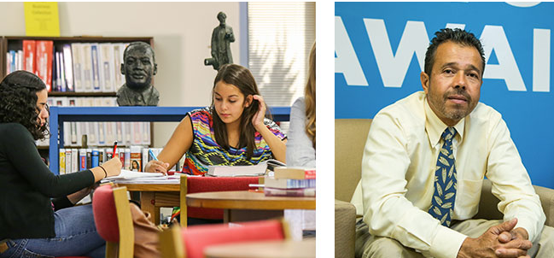
Vision
Exceed expectations of our stakeholders by delivering quality education, exceptional workforce training, and broad community enrichment opportunities to the community.

Slide 4
BCC’s Core Values
Excellence: Fostering a culture of continual advancement through superior academics and quality service.
Respect: Accepting and appreciating the worth and contributions of ourselves, others, and the College.
Integrity: Vigilantly upholding the highest standards of fair, ethical, and honest behavior.
Opportunity: Helping our students, employees and community reach their potential by supporting success through education.
Community: Cultivating and nurturing a welcoming environment of trust and belonging through collaboration and partnerships.

Slide 5
Title IX – Civil Rights Law
BCC is committed to ensuring equal access to its educational programs without regard to sex, gender, race, color, national origin, religion, age, disability, pregnancy, gender identity, sexual orientation, predisposing genetic characteristics, marital status, veteran status, military status, domestic violence victim status, or ex-offender status. BCC is also committed to providing an environment not impaired by sex and gender-based misconduct, including sex discrimination and sexual harassment.
Title IX Coordinator:
Adrienne Gray, Nursing
910.755.6634
graya@brunswickcc.edu
Health Sciences Building
Monday – Thursday, 8-4, Friday, 8-12
What are your rights?
A safe environment: BCC will take the necessary measure to protect the safety of the campus community.
Respect: All parties involved in any incident will be treated with dignity and respect.
An adequate, reliable and impartial investigation.
Advocacy, counseling and confidential support services.
Remedies: As necessary.
Additional Title IX Information on BCC’s Website

