Slide 1
Getting Connected What you Need to Know

Slide 2
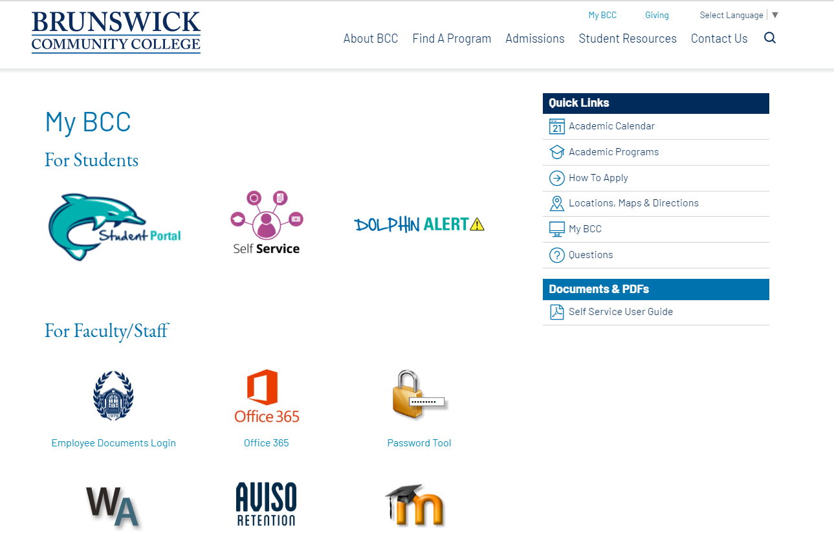
Let’s Get Connected
You only need to remember one password to access BCC’s technology.
Student Technology Orientation
Password Reset and Change: Initial set, reset, and change passwords. Passwords Expire every 90 days
Student Email
Moodle Login
Self-Service
Dolphin Alert
MyBcc Website

Slide 3
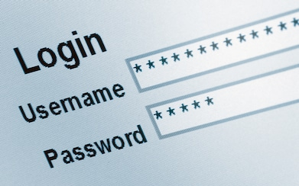
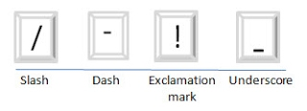
UserID and Password
Usernames are issued during admissions process and are provided in your Acceptance Email. The standard username format is the first four letters of your first name (all lowercase) and the last five numbers of your student ID number.
Set your initial password and manage passwords through your Student Portal, Password Set and Reset
Format:
8-10 characters
Begin with letter or number
Include both upper and lower case letters
One special character – Use one of these special characters :
Instructional Technologies
(Distance Learning)
Building A (2nd Floor, Library)
brunsdl@brunswickcc.edu
910.755.7390

Slide 4
Dolphin Alert
You must register your phone number or email address within DOLPHIN Alert to receive notifications from Brunswick Community College about campus updates, closings, delays, critical weather, or any other emergency notification.
To join, text the group name below (i.e. #main, #fitness, etc.) to (910)202-4330 or log into MyBCC and select Dolphin Alert.
DOLPHIN Alert Groups
#main – Main Campus
#fitness – Fitness and Aquatics Center
#Leland – Leland Satellite Campus
#owa – O’Dell Williamson Auditorium
#southport – Southport Satellite Campus
You will receive a confirmation text for each group you join.
Dolphin Alert Website

Slide 5
How to Access Courses
Moodle, is the course management system BCC uses for all classes, especially hybrid, blended, and online courses. It enables instructors to provide students access to course materials, communication tools, online assessments and grades, as well as the ability to submit assignments electronically.
Moodle is accessed through BCC’s Student Portal.
Your courses will not appear in Moodle until the start date of your class. For hybrid, blended, and online courses, you must immediately complete the “Enrollment Assignment” to remain enrolled in the course.
NOTE: Before classes begin, complete the Technology Orientation within Moodle to become familiar with BCC’s technologies. The Orientation link appears on the right hand side of BCC’s Moodle’s main webpage.
Instructional Technologies
(Distance Learning)
Building A (2nd Floor, Library)
brunsdl@brunswickcc.edu
910.755.7390

Slide 6
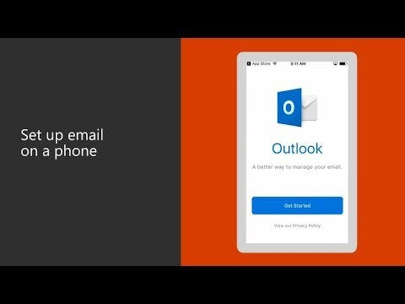
Student Email
As a BCC student, you have an official student email. BCC uses your student email address to send you important communications. It is the official way of communication between the student and the College.
Your email address is formatted as:
username@ brunswickcc.edu.
Access your email through BCC’s Student Portal or through outlook.com/brunswickcc.edu
Any questions related to your email account should be directed to:
brunsdl@brunswickcc.edu
910.755.7390
Setting up Email Video

Slide 7
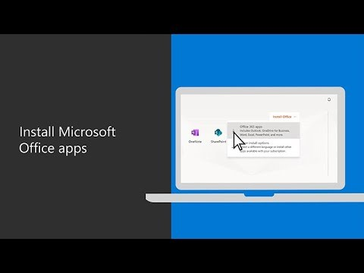
Office 365
As a BCC Student you have access to a Microsoft 365 for all of your educational needs. To access:
Log in to your email account the BCC’s Student Portal or go to outlook.com/brunswickcc.edu
View the videos in Moodle for step-by-step instructions on how to download and install apps on your computer, phone, and other hand-held devices.
Install Microsoft 365 on your Computer
Install Microsoft 365 on Phone and Other Devices

Slide 8
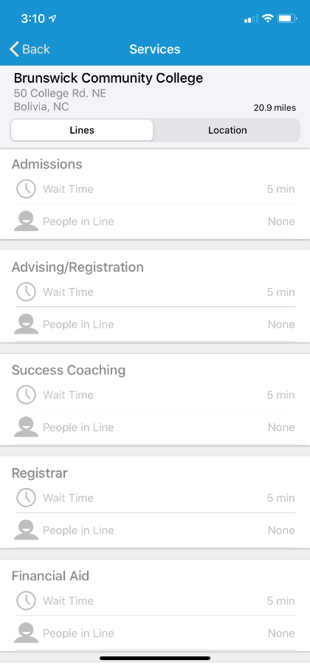
Qless
Need to visit Student Services?
Office of Admissions
Office of Advising/Registration
Office of Registrar (records/graduation/transcripts)
Office of Financial Aid
Tutoring Services (coming soon!)
Get the QLess App
Check Wait Times
Join the Virtual Line. Wait where you want and we will text you when it is your turn
Receive updates of your wait times

Slide 9
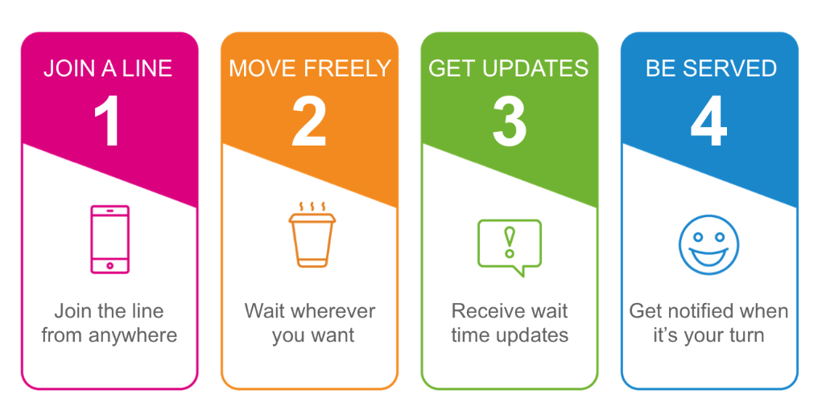
Qless Virtual Line
How do I join the line?
Text Message: Text the word dolphin to 910.218.8512 and follow the prompts. Standard text rates will apply.
App: Download the Qless App or go to your APP Store on your hand-held device.
Online: Use the Qless widget, Qless Kiosk Login, enter your phone information, and click the line you would like to join, then click the “Join This Line“ button
In person: Self-service kiosks are in the Office of Student Service lobby area, Building A. If you need help, staff can assist you in joining the line.
Office of Admissions
Office of Advising/Registration
Office of Registrar
Office of Financial Aid
Tutoring Services (coming soon!)

Slide 10
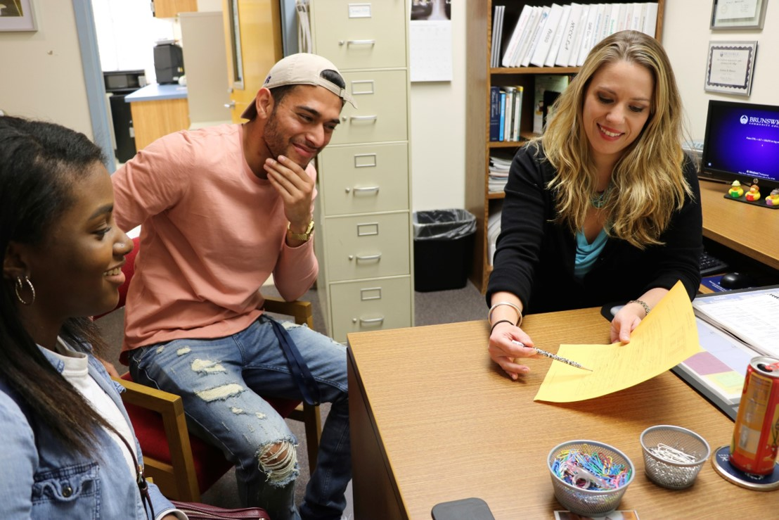
Register Now
Register Now!
A Success Coach/Advisor must approve your schedule prior to registering for classes.
To schedule a Zoom chat session, email a Success Coach at:
academicsupport@brunswickcc.edu
Accepting appointments:
Monday thru Thursday, 8-4
Friday 8-12:00
Self-Service Guide
Registering for Classes
Quick Guide to
Confirm Registration

