Slide 1
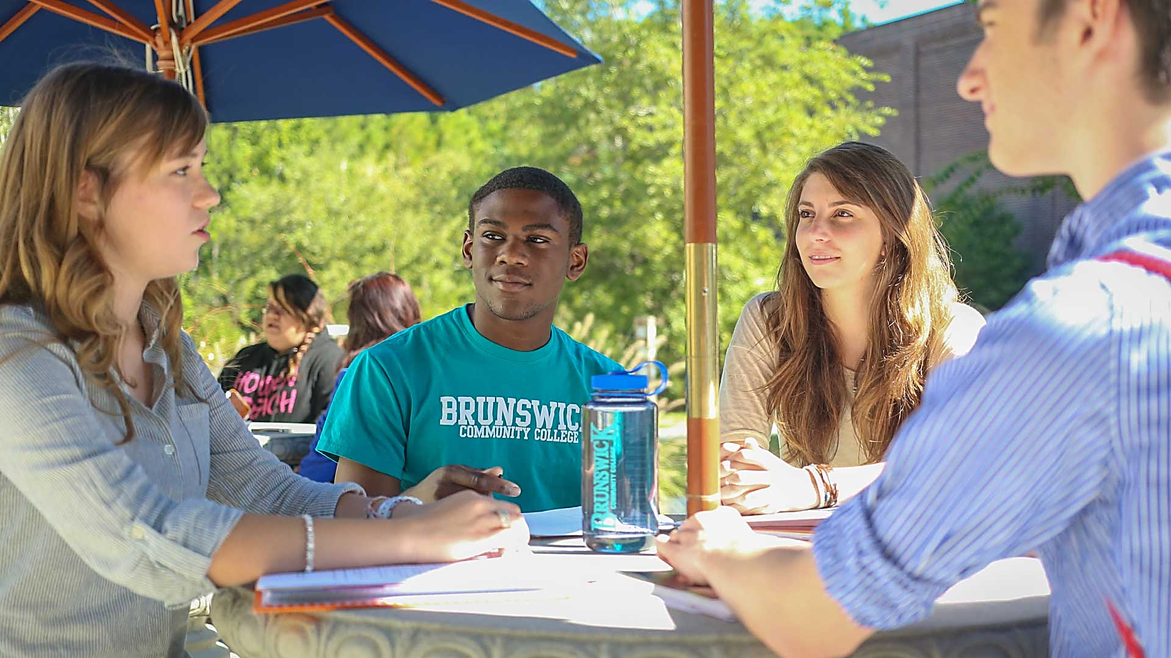
Additional Resources & Student Life

Slide 2
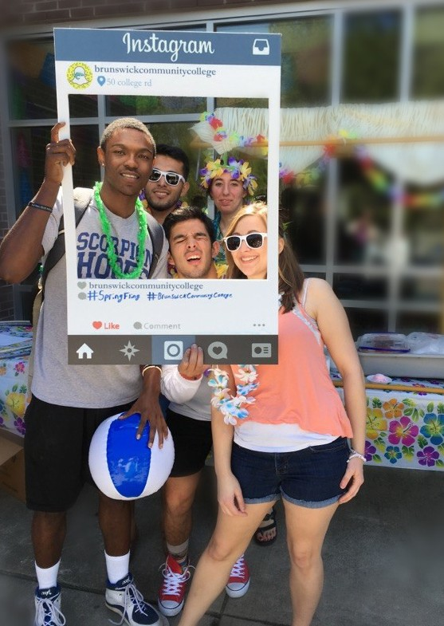
Student Life – Student Activities
College life isn’t all about books and exams. Get involved in campus activities. Find a club to join, become a Student Ambassador, go to SGA meetings or run for SGA office, be part of the flag football team, or help plan campus-wide student activities.
Office of Student Life
Building A
olsenj@brunswickcc.edu
Attend an athletic event (free admission for students, faculty, and staff). Go Dolphins!

Slide 3
SGA
The Student Government Association is the primary voice of students that promotes the welfare of students. SGA advises College administrators on improving student life and helps student services carry out annual events funded by Student Activity fees.
Curriculum students registered and attending the College are members of the Student Government Association. SGA Officers when needed are elected by the student body at the start of each Fall semester:
President
Vice President
Secretary
Treasurer
Parliamentarian
Public Information Officer
Contact the Office of Academic Support if you are interested in applying for an Officer position. Monthly SGA meetings are held in Dolphin Cove, Building A.
Student Government Association
Office of Academic Support
Building A, Room 125
academicsupport@brunswickcc.edu
Let your voice be heard!
Get Involved.

Slide 4
Child Care Assistance
Childcare Assistance Funds (CAF) can help students offset the cost of daycare expenses for their children. To qualify for Childcare Assistance Funds assistance, you must:
be a full- or part-time BCC student;
been denied by DSS for child care assistance or wait listed; and
the childcare provider must be an approved, reliable public daycare facility
Office of Student Life
Building A
olsenj@brunswickcc.edu
To apply, complete a CAF Application (available in the Office of Student Services) and submit a birth certificate for the child/children being considered. Apply early! CAF are awarded on a first-come, first-serve basis as funds remain available.

Slide 5
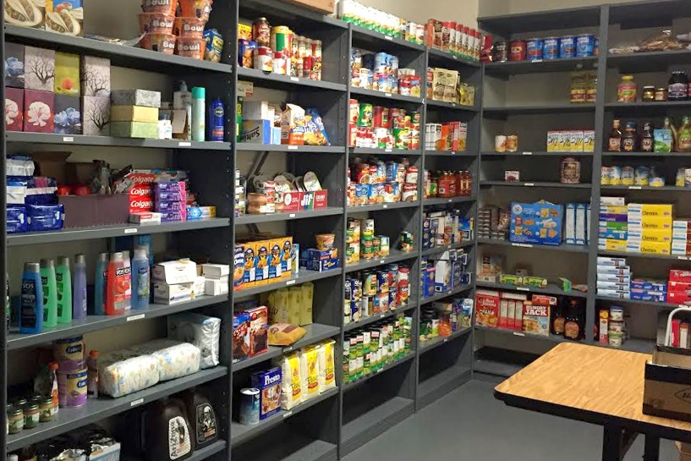
Food Pantry
The Food Pantry provides students who are in need of help and short on food. We care and we are here to help!
Office of Student Life
Building A
olsenj@brunswickcc.edu
Summer Hours:
Monday - Thursday, 8 a.m. - 4 p.m.
Friday, 8 a.m. - 12 p.m.
Services are private and confidential.

