Slide 1
Select the right Program of Study before you start your First Semester
Image provided by: Stepstocollege.com

Slide 2
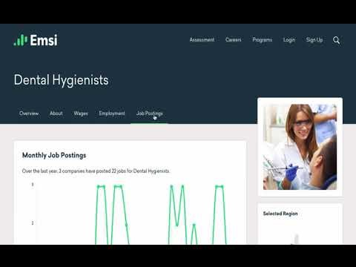
Career Counseling
We want to assure that you select a Program of Study that matches your career interest. BCC’s Career Counselor helps you examine your interests, values, and skills as you explore career options. Upon request, a Career Counselor can also help you transition into the workforce or higher learning institutions.
Contact the Office of Academic Support to arrange an appointment. In the meantime, explore BCC’s Career Coach webpage for Programs of Study, earning potentials, and links to local jobs.
Career Coach Video
Office of Academic Support
Building A, Room 125
academicsupport@brunswickcc.edu
BCC's Career Coach Website

