Slide 1
We are here for you!

Slide 2


Your Success Team
Success Coaches help you get started and keep you on course to overcoming barriers to your success.
Faculty Advisors guide you in making informed career and academic decisions.
Academic Coaches in TLC work with you to assess your strengths and needs, provide tutoring services, and help you develop a personalized plan of action to help you succeed.
Faculty
Advisor
Success
Coach
Academic
Coach
Office of Academic Support and Learning Resources
Building A
academicsupport@brunswickcc.edu

Slide 3
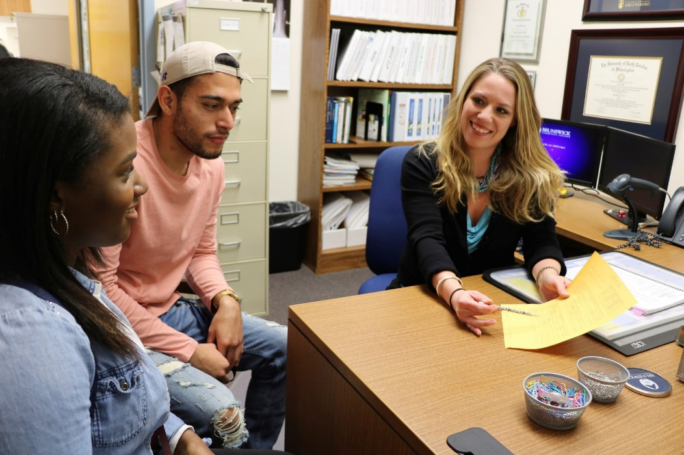
Mentoring/Leadership Programs
BCC’s Mentoring and Leadership Programs are open to enrolled students to help build stronger students, leaders, and achievers.
Participating in a leadership program provides you an opportunity to work with your peers, community leaders, and mentors inside/outside the college.
Get involved! Contact BCC’s Mentoring and Leadership Success Coach in the Office of Academic Support.
Office of Academic Support
Building A, Room 125
academicsupport@brunswickcc.edu

Slide 4


Satisfactory Academic Progress
You are expected to maintain satisfactory academic progress towards completing your associate’s degree, diploma, or certificate program. Satisfactory academic progress means that you are maintaining a cumulative Program of Study grade point average of 2.0 or higher.
Financial aid recipients must maintain Satisfactory Academic Progress to remain eligible for financial aid, grants, and scholarships.
Career College Promise students must continue making progress towards high school graduation and maintain a 2.0 GPA in their college course work to enroll in college courses the following semester.
Report Cards/Grades are not mailed. Grades are posted a few days after each semester. View your grades through Self-Service.

Slide 5
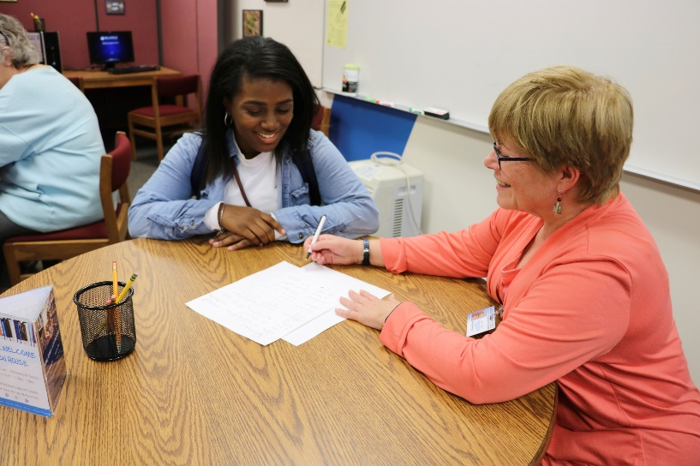

Academic Alerts
Your instructors, Success Coach, and Faculty Advisor want to provide you with the best chance to improve your course grade before it is too late to recover.
BCC’s AVISO Retention software helps to identify students who may be experiencing difficulty in and beyond the classroom. Your Success Team may receive an Academic Alert on your behalf for a variety of reasons, including:
irregular attendance, or you stopped attending class;
patterns of missed assignments or low grades on assignments or exams; or
difficulty understanding course materials
When received, your Success Coach will reach out to you by email, phone, or in person to provide advising, mentoring, coaching support to help get back on track to success. Your success is our success!
Office of Academic Support
Building A, Room 125
academicsupport@brunswickcc.edu

Slide 6
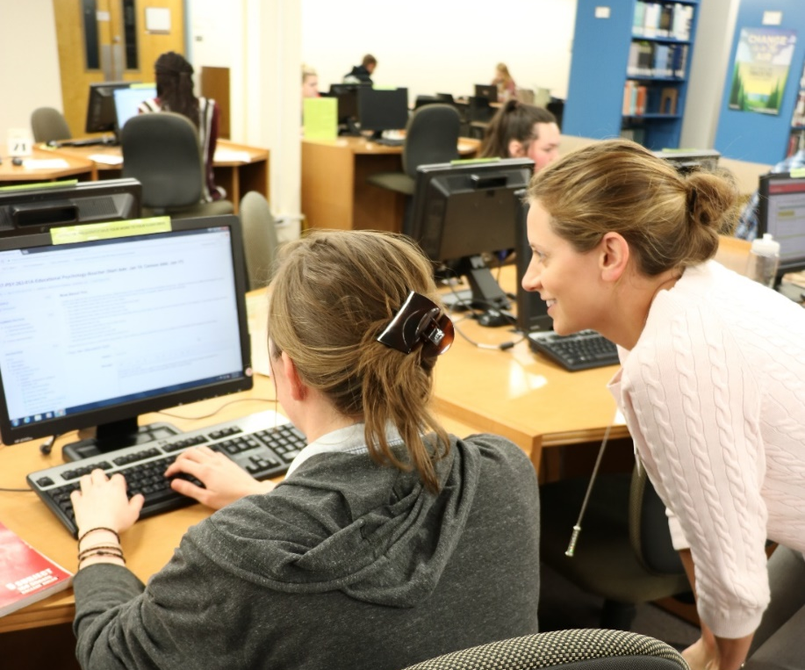
Learning Resources Center
The Library is the learning resource hub of the college providing students with information resources, technology, and tutoring services. Students can meet with tutors, use computers, study, work independently or in groups to collaborate with others in technology equipped spaces.
The Library website portal provides free access to eBooks, audiobooks, video clips, movies, newspaper, and journal articles. These resources will help you with class assignments, research papers, and projects. Library staff can assist you in locating your research resources and a 24/7 chat service is available on the Library Portal to assist you with research and navigating electronic resources.
Monday – Thursday 7:30 am -7:30 pm*
Friday 8:00 am – 3:00 pm*
*Summer hours may vary
Building A, 2nd Floor
BCC Library Website

Slide 7

The Learning Center (TLC)
The Learning Center (TLC) offers individual face-to-face tutoring, writing assistance, testing, studying, and technology services throughout the day within the Learning Resource Center.
Building A, 2nd Floor
BCC also offers online tutoring services 24/7 through your Moodle Smarthinking portal. Tutoring is available for English, math, sciences and other subject areas. Stop by the Learning Resource Center for the latest tutoring schedule and additional information on Smarthinking access.
Smarthinking Video

Slide 8

Disability Resources
The Office of Disability Resources provides accommodations for students with visual impairments, learning disabilities, mobility impairments, hearing impairments, chronic health conditions, psychological disabilities and temporary disabilities so that they may enjoy a complete range of academic and non-academic opportunities. Simply put, BCC provides support for students who will require extra help to navigate the campus or classroom.
To request accommodations:
Schedule an appointment with the Office of Disability Resources
Have your disability documented by a qualified professional such as a physician, psychologist, or psychiatrist. Contact your high school to obtain a copy of your latest IEP/504.
Bring a copy of your documentation to your Disability Services Resources appointment.
Office of Disability Resources
Building A, Student Services
910.755.7338

Slide 9

Academic Success Courses
Academic Success courses help you to transition into college by focusing on the skills you need to succeed.
All degree and diploma programs require students to complete a Academic Success course in the first semester.
  Understand how differently we all learn.
  Understand what your instructors expect of you and how to establish a constructive relationship with them.
  Develop strong study skills, learn to manage your time, and set priorities and goals.
Career College Promise students enroll in Academic Success Courses as they appear in their selected Program of Study and Early College High School students enroll in an Academic Success Course once they are a senior in high school.

