Slide 1
No one ever told me!

Slide 2
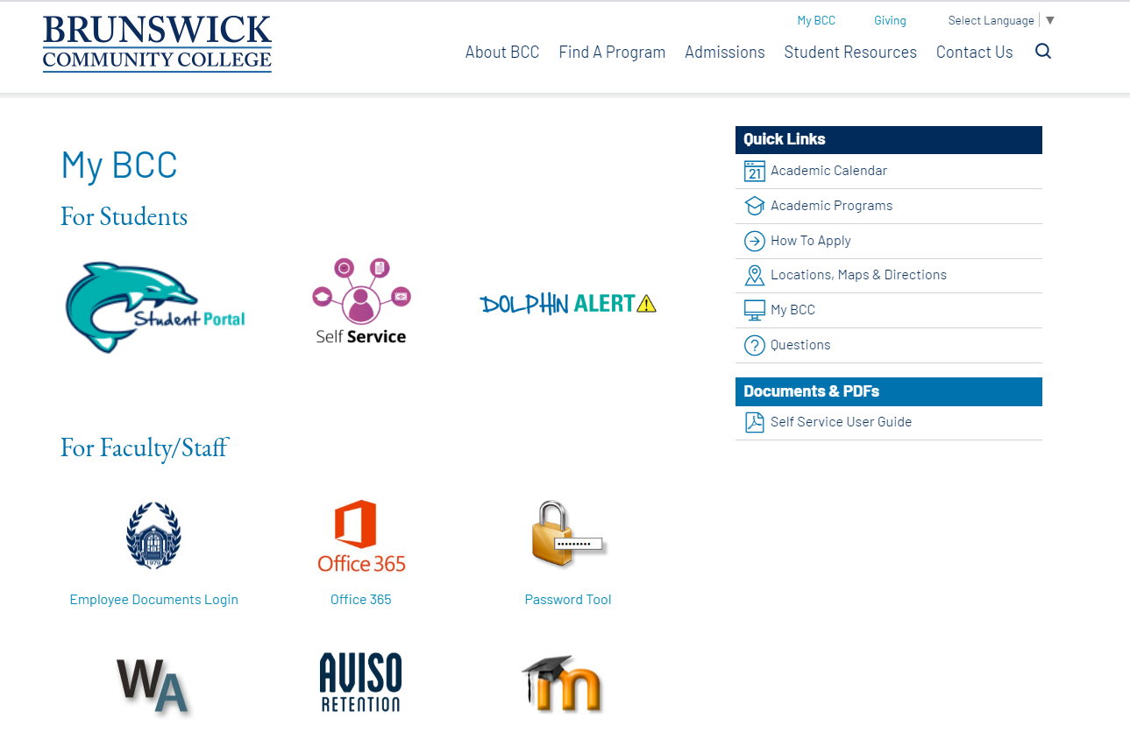
Access your Academic Planning Tools through Student Portal
My BCC
MyBCC Website
Self Service Website

Slide 3
Intake Advising Appointment
Your Intake Advising Appointment is an interactive meeting between you and your Success Coach. Your Success Coach:
helps smooth out your transition into college;
affirms your selected program of study;
assists you in developing an individual academic plan;
helps you select the appropriate classes for your career goals;
provides you with support resources; and
answers any questions you may have about the college, its programs and support resources and services.
In-person, phone, or Zoom Intake Advising are usually conducted by appointment only. Drop-ins are not encouraged given unknown wait times.
Office of Academic Support
Building A, Room 125
Summer Hours: Monday – Thursday 9-4
Friday 9-11
academicsupport@brunswickcc.edu

Slide 4
Degree Programs
BCC offers over 29-degrees programs for students seeking a 2-Year Associate degree who may later plan to enroll at University to obtain a 4-year baccalaureate degree. Offerings include:
Associate in Applied Science
Associate in Arts
Associate in Arts – Business Administration
Associate in Arts – Teacher Prep
Associate in Engineering
Associate in Science
Associate in Science - Computer Science
Associate in Science- Teacher Prep
Check out BCC’s Career Coach webpage to explore careers that link with BCC’s Programs of Study and local jobs.
BCC's Degree Program Webpage

Slide 5
Career Programs
BCC offers additional diploma, and certificate programs that prepare students for entry-level jobs in the community. These programs are a stepping stone to an Applied Science Degree and provide students with specialized training and skills that enable them to become employable and competent in their discipline, and in many cases, earn industry-recognized certifications.
Students who complete career programs also earn credit towards completing a 2-year Applied Science Degree to enter into a University at Junior status to complete a baccalaureate program.
BCC's Website: Professional/Technical Career Programs

Slide 6
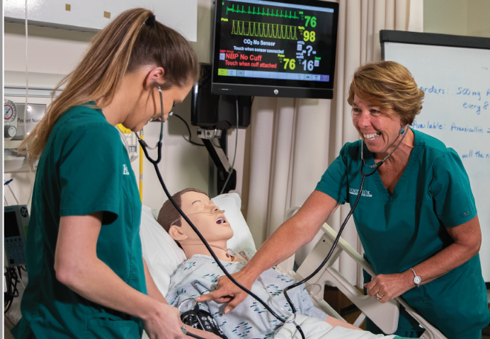
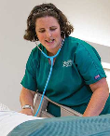
Health Science Programs
Health Sciences Programs prepare graduates to be clinical professionals in healthcare provider’s offices, hospitals, and other businesses in the healthcare industry.
Both the Associate Degree Nursing and Practical Nursing programs have competitive admission processes and you must apply for admission to these programs.
Emergency Medical Science curriculum provides individuals with the knowledge, skills and attributes to provide advanced emergency medical care as a paramedic for critical and emergent patients and serve as a link from the scene into the healthcare system.
BCC's Website: Health Science Programs

Slide 7
Online Classes
Online classes are usually recommended for second semester students and those who have previous online learning experience; however, sometimes they are unavoidable.
Why Online Classes? Online courses are effective and flexible and provides a chance for anyone, located anywhere, without restrictions, to have access to the educational opportunities. You learn the same content of classes taught on-campus. However, succeeding in online courses means you need to be motivated, self-disciplined, and organized. When enrolling in an online course you should have access to, and be comfortable using a computer and the Internet.
What Online Courses Are Not Students sometimes believe that online courses are an easy alternative to the traditional method of classroom instruction and that there won't be as much work. In most instances, this is not true. Online courses are just as rigorous as any on-campus course, sometimes more. This method of instruction places more responsibility for learning on you, the student. You do not have an instructor physically in the classroom giving you your next assignment or reminding you of due dates. Obtaining feedback and answers to your questions is not real time. In some instances, it can take up to 24 hour before you receive a response.

Slide 8
How to be Successful in Online Classes
You should already know how to:
Operate a computer
Log on to the Internet
Use Word Processing Software
Type, cut, paste, copy, name, save and rename documents created
Send email
Attach files to email messages
Download information from the Internet
Browse the Web
Expect the Unexpected!
Have a backup plan in case your computer breaks or you lose access to the Internet. Know who to contact if you need technical assistance or help with 3rd party software.

Slide 9
Schedule Changes
Students may add or remove a class from their schedule up until the first two days of the semester. To avoid a 25% tuition charge, class schedules must be adjusted before the first day of class. Technology and student fees are non-refundable.
After the course census date, a student must withdraw from the course to drop it from their schedule. A withdraw appears as a “W” on a student’s transcript.
Changing your schedule may impact Financial Aid eligibility. Before dropping a course, make sure to meet with a Financial Aid Counselor to discuss your options.
Office of Academic Support
Building A, Room 125
academicsupport@brunswickcc.edu
NOTE: CCP/ECHS students may not make change their schedules without prior approval from their respective high school Guidance Counselor and BCC’s NC Career Coach.

Slide 10
Course Withdraw
You are strongly encouraged to discuss your progress with your Instructor, Faculty Advisor and Success Coach prior to making a final decision to withdraw from a course.
Although withdrawing from a course does not affect your GPA, it impacts your attempted hours, which in turn, may effect your continued eligibility for financial aid and scholarships.
Course Withdraw
Office of Academic Support
Building A, Room 125
academicsupport@brunswickcc.edu
Withdraws must be requested before the 75% point of the course as withdraws are not accepted towards the end of the term. If you withdraw prior to the 60% point of the semester, you may be obligated to pay back a portion of the financial aid you received.
NOTE: CCP/ECHS students may not withdraw from a class without prior approval from their respective high school guidance counselor and BCC’s NC Career Coach.

Slide 11
Program of Study Changes
We want to assure that you select a Program of Study to match your Career interest before classes begin. Changing your program after classes begin may impact your financial aid eligibility and anticipated graduation date.
If contemplating a Program of Study change, we recommend you meet with your Success Coach or Faculty Advisor to discuss your options. You also need to review your official BCC transcript to assure that any previous completed classes that qualify under the new Program of Study appear on your transcript.
NOTE: Program changes must be completed within the first three weeks of the semester. Program of Study requests received after this time are processed with an effective date of the start of the next term.
Office of Academic Support
Building A, Room 125
academicsupport@brunswickcc.edu

Slide 12
Access your Academic Planning Tools through MyBCC Student Portal
Student Technology Orientation
Password Reset and Change
Student Email
Moodle Login
Self-Service
Dolphin Alert
Guide for Using Self-Service Planning
Self-Service Login Webpage

